Slide 1


12.08.2025
Simulating Dyna Lab cooling system
Deepak
© Fraunhofer IWES/Gerrit Wolken-Möhlmann

Slide 2
Agenda
Table of content
Original System overview
DynaLab Auxiliary system setpoint
Simscape Model
Subsystem overview
Chiller subsystem overview
Test Cases
Control Logic
MATLAB Dashboard and Manual Control
Results

Slide 3
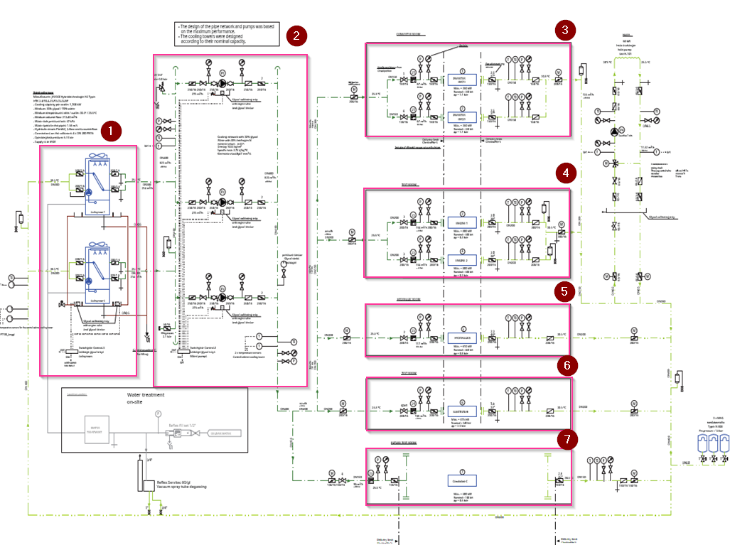
System overview
Original system
Coolant Loop: 30% glycol / 70% water mixture circulation.
Pumping Subsystem: Central manifold with multiple centrifugal pumps in parallel.
Heat Input Subsystem: Test benches and equipment introduce up to 3,400 kW thermal load.
Heat Rejection Subsystem: Hybrid cooling towers reduce coolant to ~25.5 °C.
Monitoring & Control Subsystem: Real-time flow, pressure, and temperature tracking.
1 – Cooling system
2 – Pump Unit
3 – Converter
4 – Motor
5 – Hydraulic room
6 – DUT
7 – Hall C

Slide 4
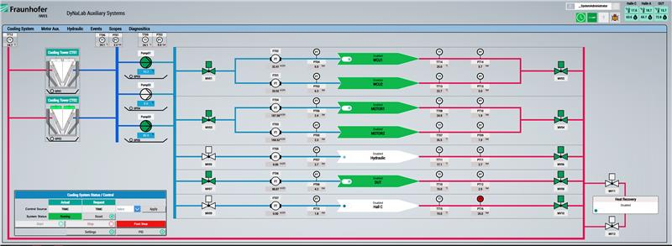
DynaLab Auxiliary system
Set Points
the actual setpoint for a proper operation are:
Glycol Density: 1032 Kg/m3
Glycol Specific Heat: 3.73 Kj/KgK
System Pressure: 5.2Bars
System Temperature: 25ºC to 30.5
PID: P=1; I=10; D=0
Pump Sequencing: Third pump (P3) activates automatically when P1 & P2 exceed 90% of maximum RPM.

Slide 5
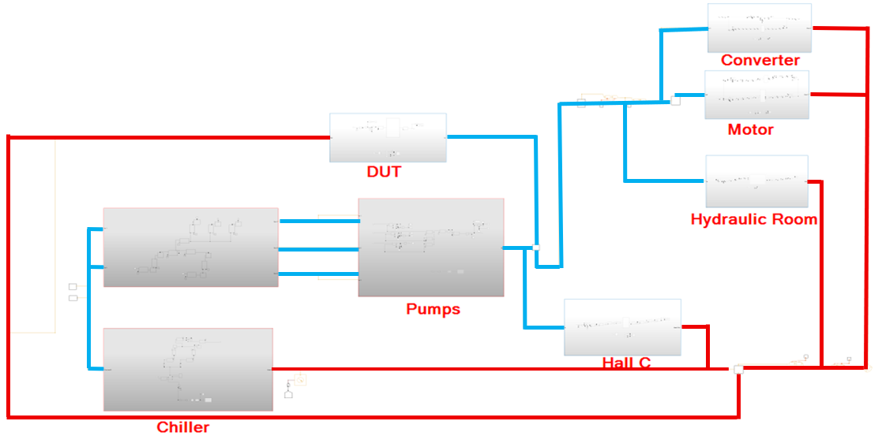
System overview
Simscape model
Cooling network modeled in MATLAB Simscape using Thermal Liquid domain.
Includes chiller units, centrifugal pumps, and thermal liquid components.
Subsystems represented: Converter Room, Motor, Hydraulic Room, DUT (Device Under Test) and Hall C
Model replicates real system topology for performance analysis and control testing

Slide 6
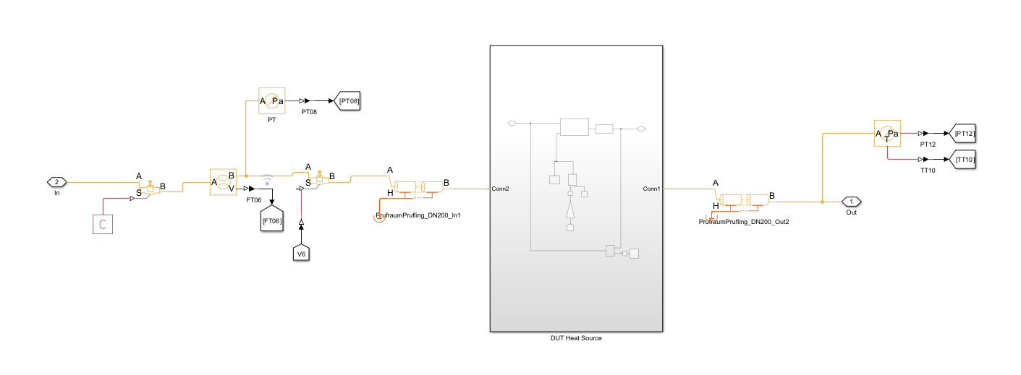
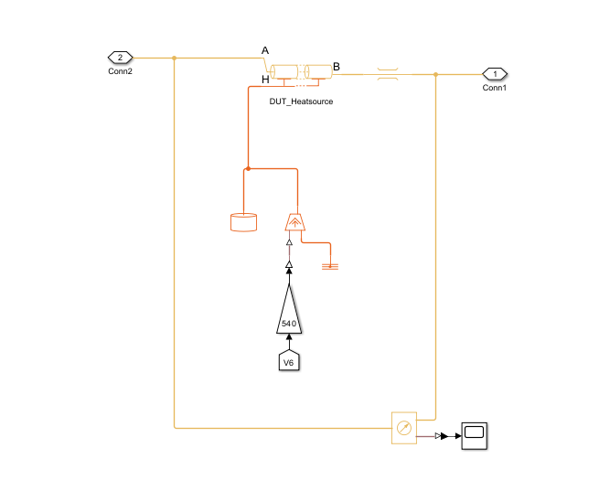
Subsystem Overview
Circulates coolant through the Device Under Test (DUT).
Contains pressure, temperature, and flow sensors for monitoring.
Equipped with control valve (V5) to regulate coolant flow.
Activates heat load when the valve opens.
Sends sensor feedback to the control logic for system regulation.

Slide 7
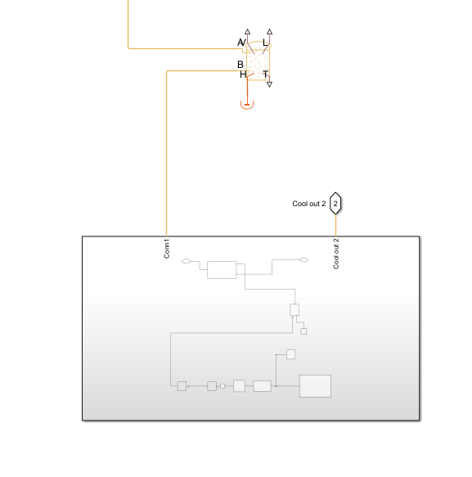
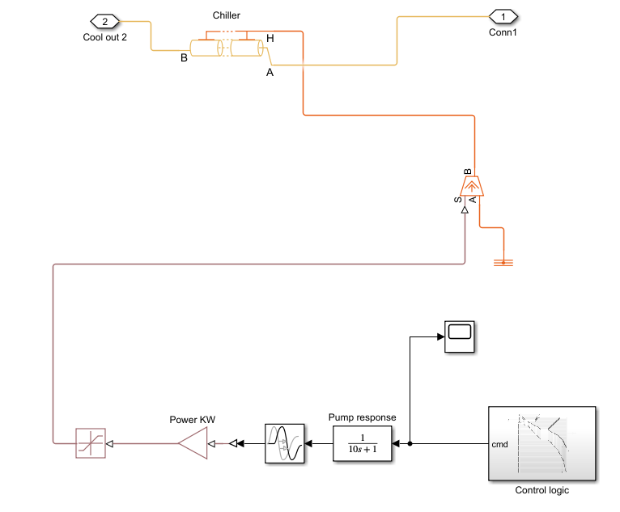
Chiller subsystem overview
Circulates coolant through the chiller for heat rejection.
Maintains coolant outlet temperature at ~25.5 °C before recirculation.
Uses integrated pump model for flow control.
Power consumption and pump response modeled for realistic behavior.
Controlled via system logic to match cooling demand.

Slide 8
Test Case
Testing different conditions
Step | Description | Time Start | Time End | Valve State (V1–V7)
1 | Everything is running | 0 | 500 | 1 1 1 1 1 1 1
2 | Converter and DUT running | 500 | 1000 | 1 1 0 0 0 1 0
3 | In addition to step 2, open motors | 1000 | 1900 | 1 1 1 1 1 1 0
4 | Open the remaining consumers | 1900 | 2800 | 1 1 1 1 1 1 1
5 | Shut everything down, keep converter & DUT running | 2800 | 3700 | 1 1 0 0 0 1 0
6 | Shut whole system down | 3700 | 4600 | 1 1 1 1 1 1 1

Slide 9
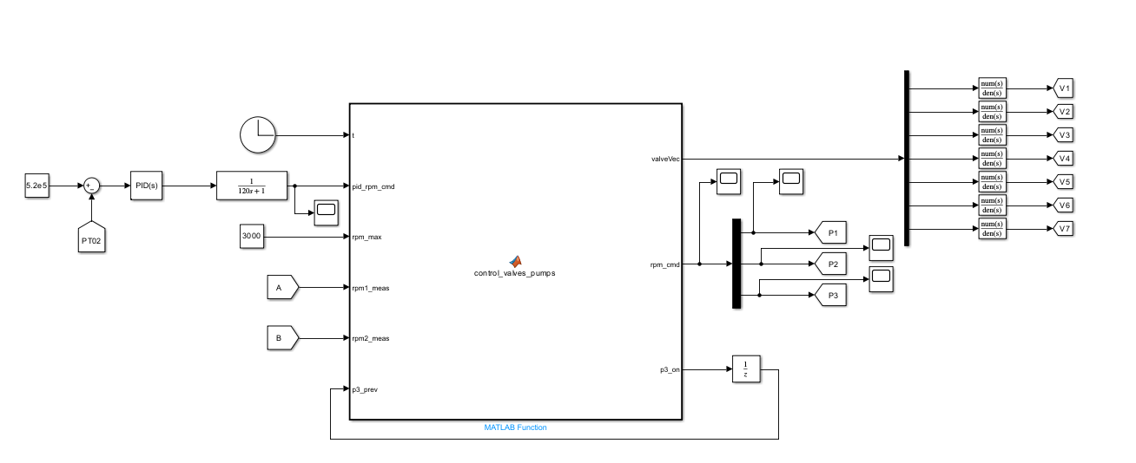
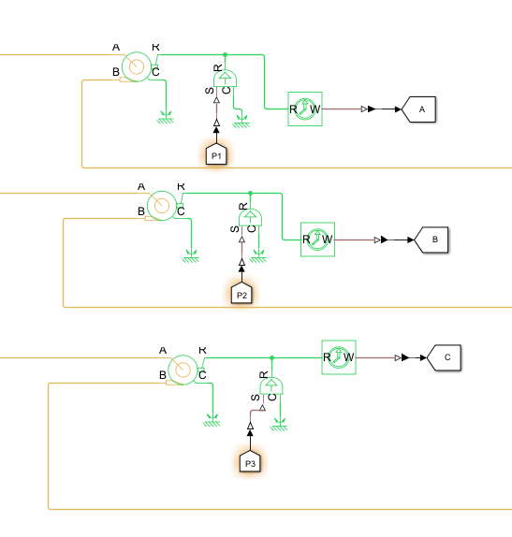
Subsystems overview
Control Logic
Pressure Control: Maintains system pressure at 5.2×10⁵ Pa via PID regulation.
Inputs: Pressure sensor feedback (PT02), pump RPM data (P1 & P2), and previous pump state.
Control Logic: MATLAB function determines valve positions (V1–V7) and pump speeds (P1–P3).
Valve–Heat Link: Each valve corresponds to a dedicated heat source; opening a valve activates its load.
Outputs: Stable pump RPM commands and valve control signals for balanced load distribution.

Slide 10
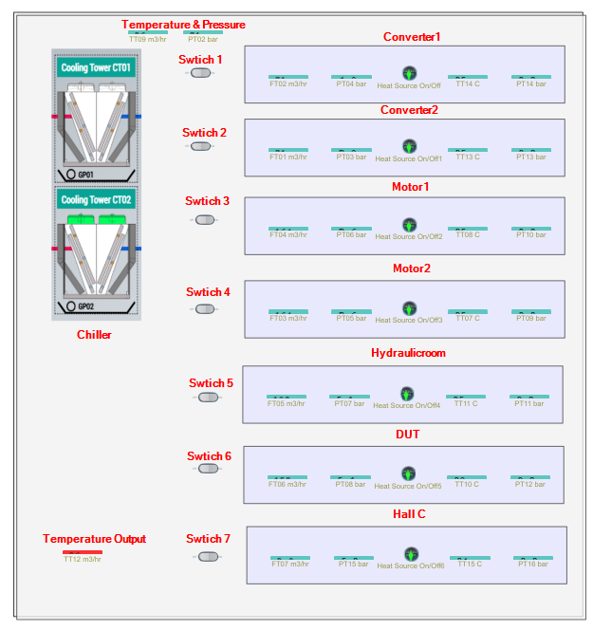
MATLAB Dashboard
Manual control
Manual interface to operate the cooling system in Simulink.
Individual switches (1–7) control the opening of valves/heat inputs for each subsystem.
Displays real-time measurements: flow rate (m³/hr), pressure (bar), and temperature (°C) for each consumer.
Allows manual chiller operation for Cooling Towers CT01 and CT02.
Used for testing control logic and verifying sensor feedback before automated operation.

Slide 11
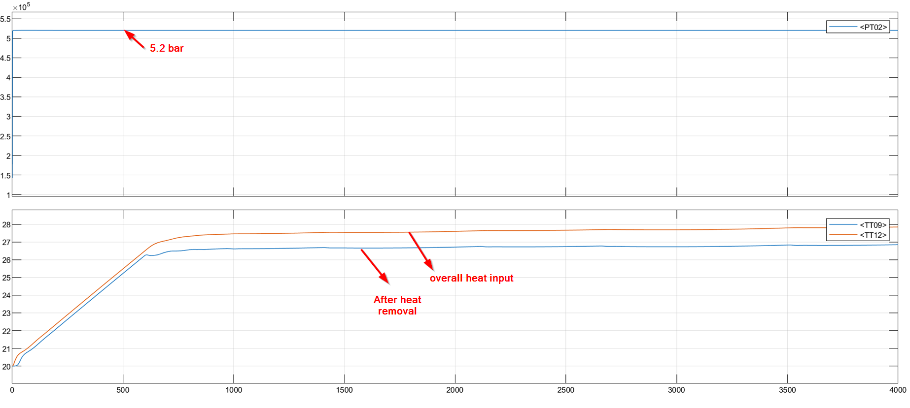
Result with all the valve open (Pressure after pump and temperature)

Slide 12
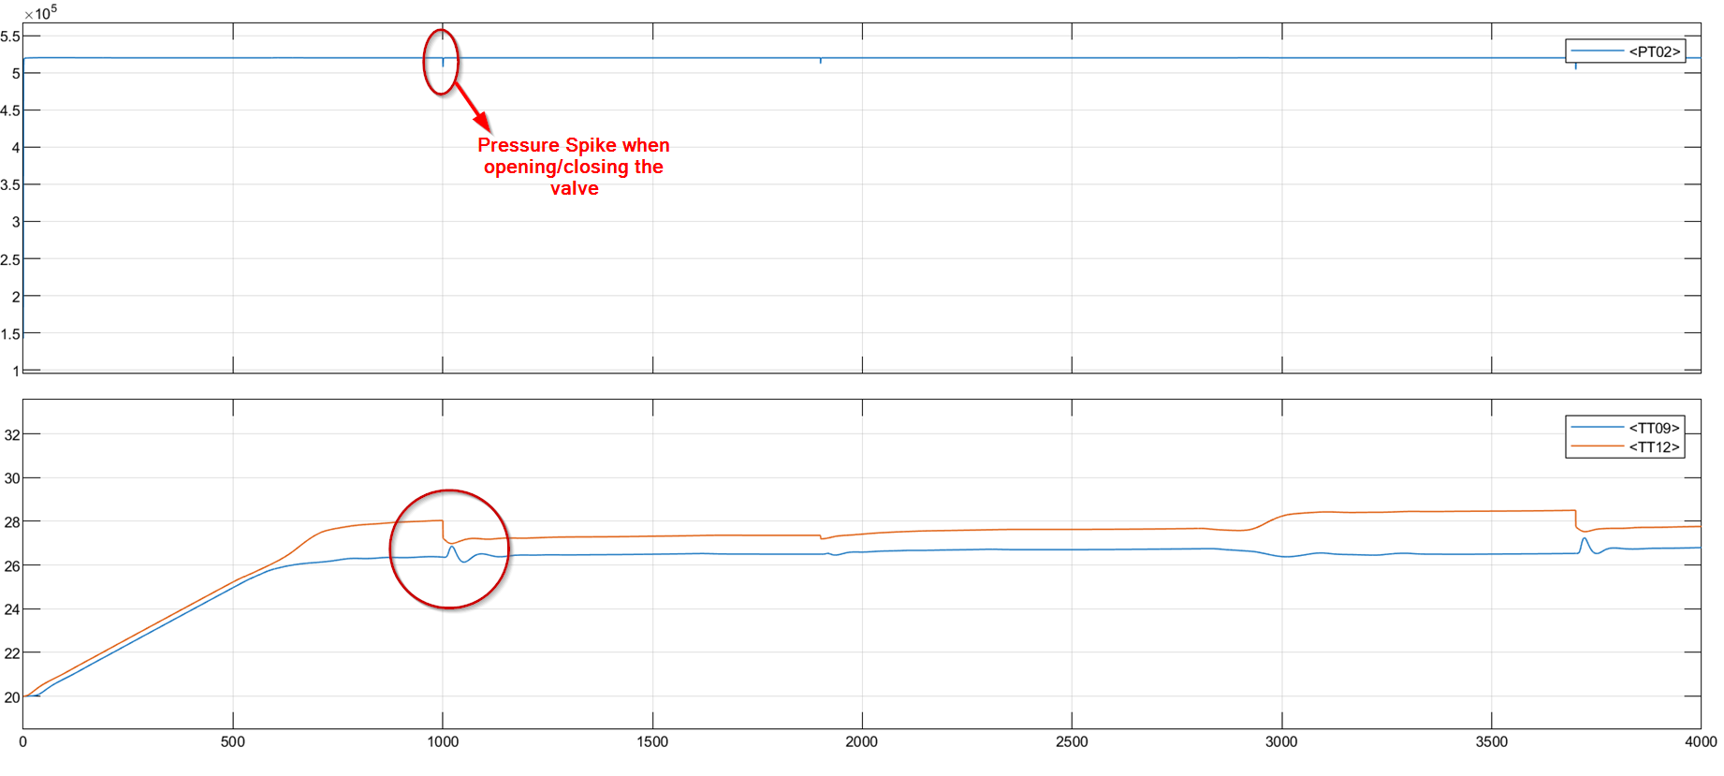
Valve operated by the test case sequence (Pressure and temperature)

Slide 13
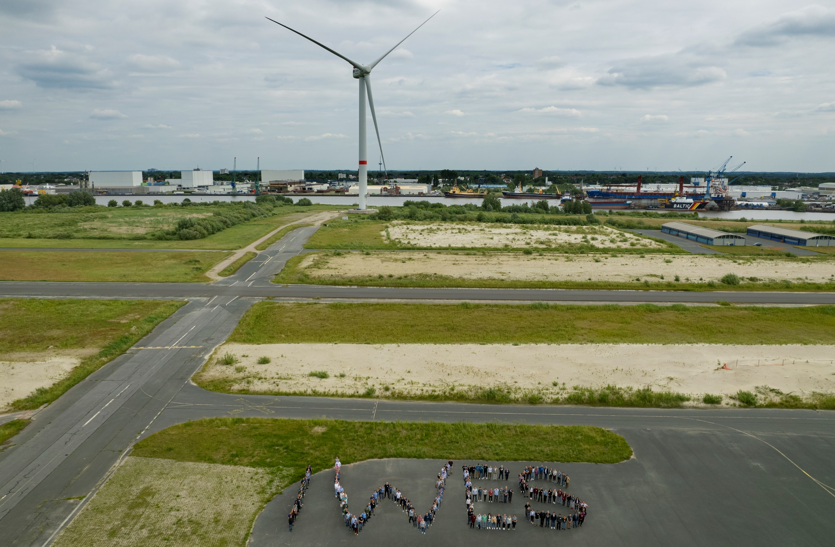
Thanks a lot for your attention!
—
© Fraunhofer IWES/Frank Bauer

